Slide 1



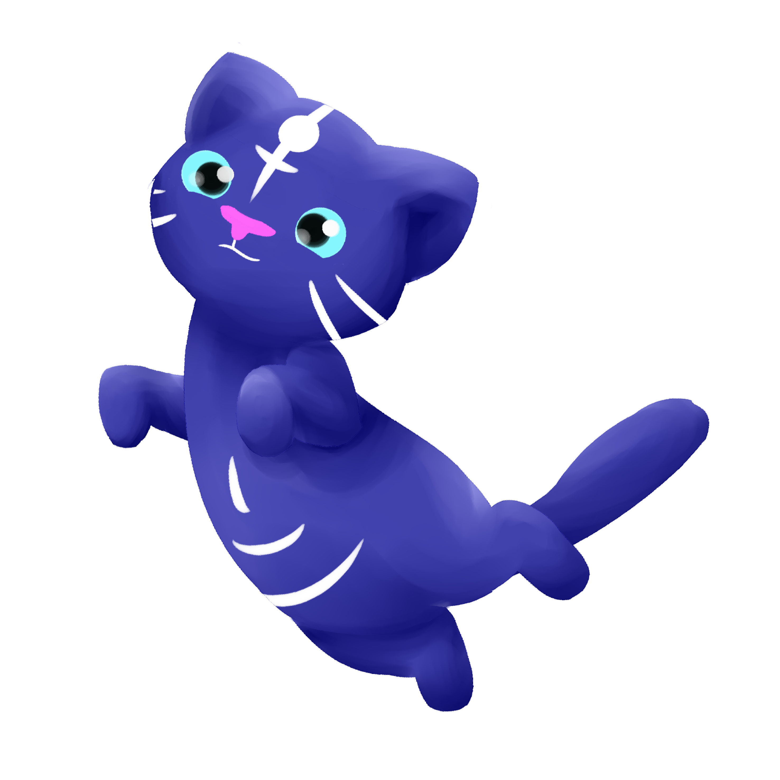
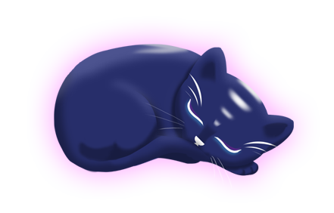

Group 6
Charlie Crewe, George Flude, Alex Polley and Callum Walsh.

Slide 2
Psychograph
Name: Maarii
Age: 48
Occupation: Admin/Sales
Marital Status: Married
Likes:
Chocolates
Toffees
Biscuits
Apple Pie
Green Tea
Earl Grey
v
Animals
Cats
Dogs
Horse
Music
Country Rock
80’s Pop
Fears/Dislikes
Insects
Large Dogs
Scaled creatures
Heights

Slide 3
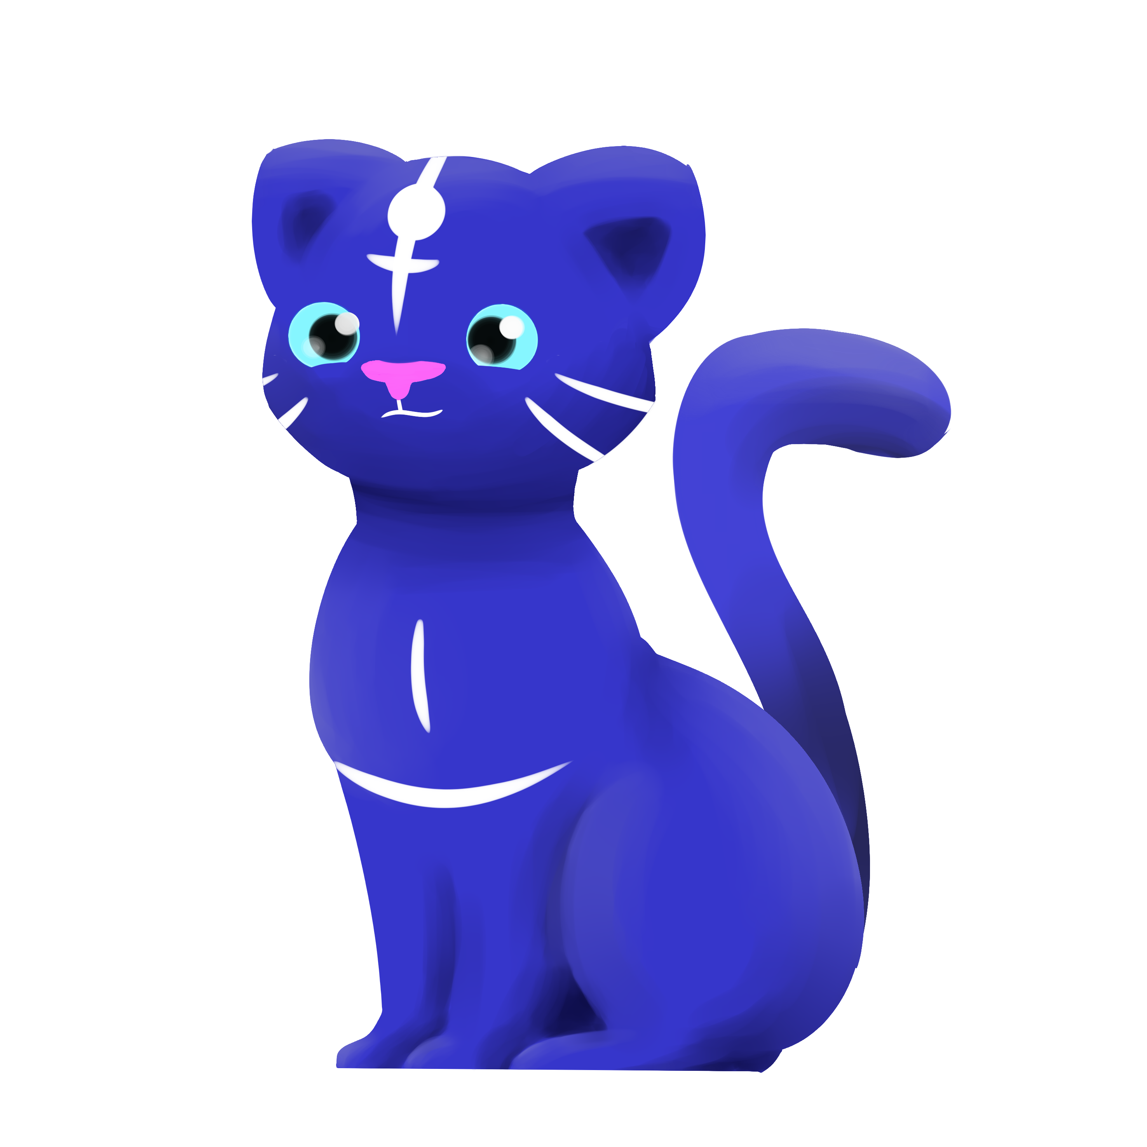
Platform
Tablet
Screen size suitable for psychographic

Slide 4
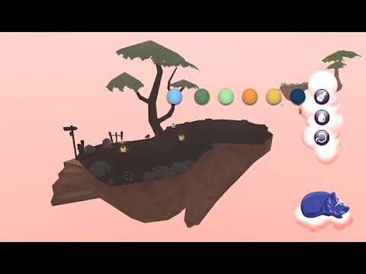
Gameplay
https://youtu.be/4Z3KbDTHbZY

Slide 5
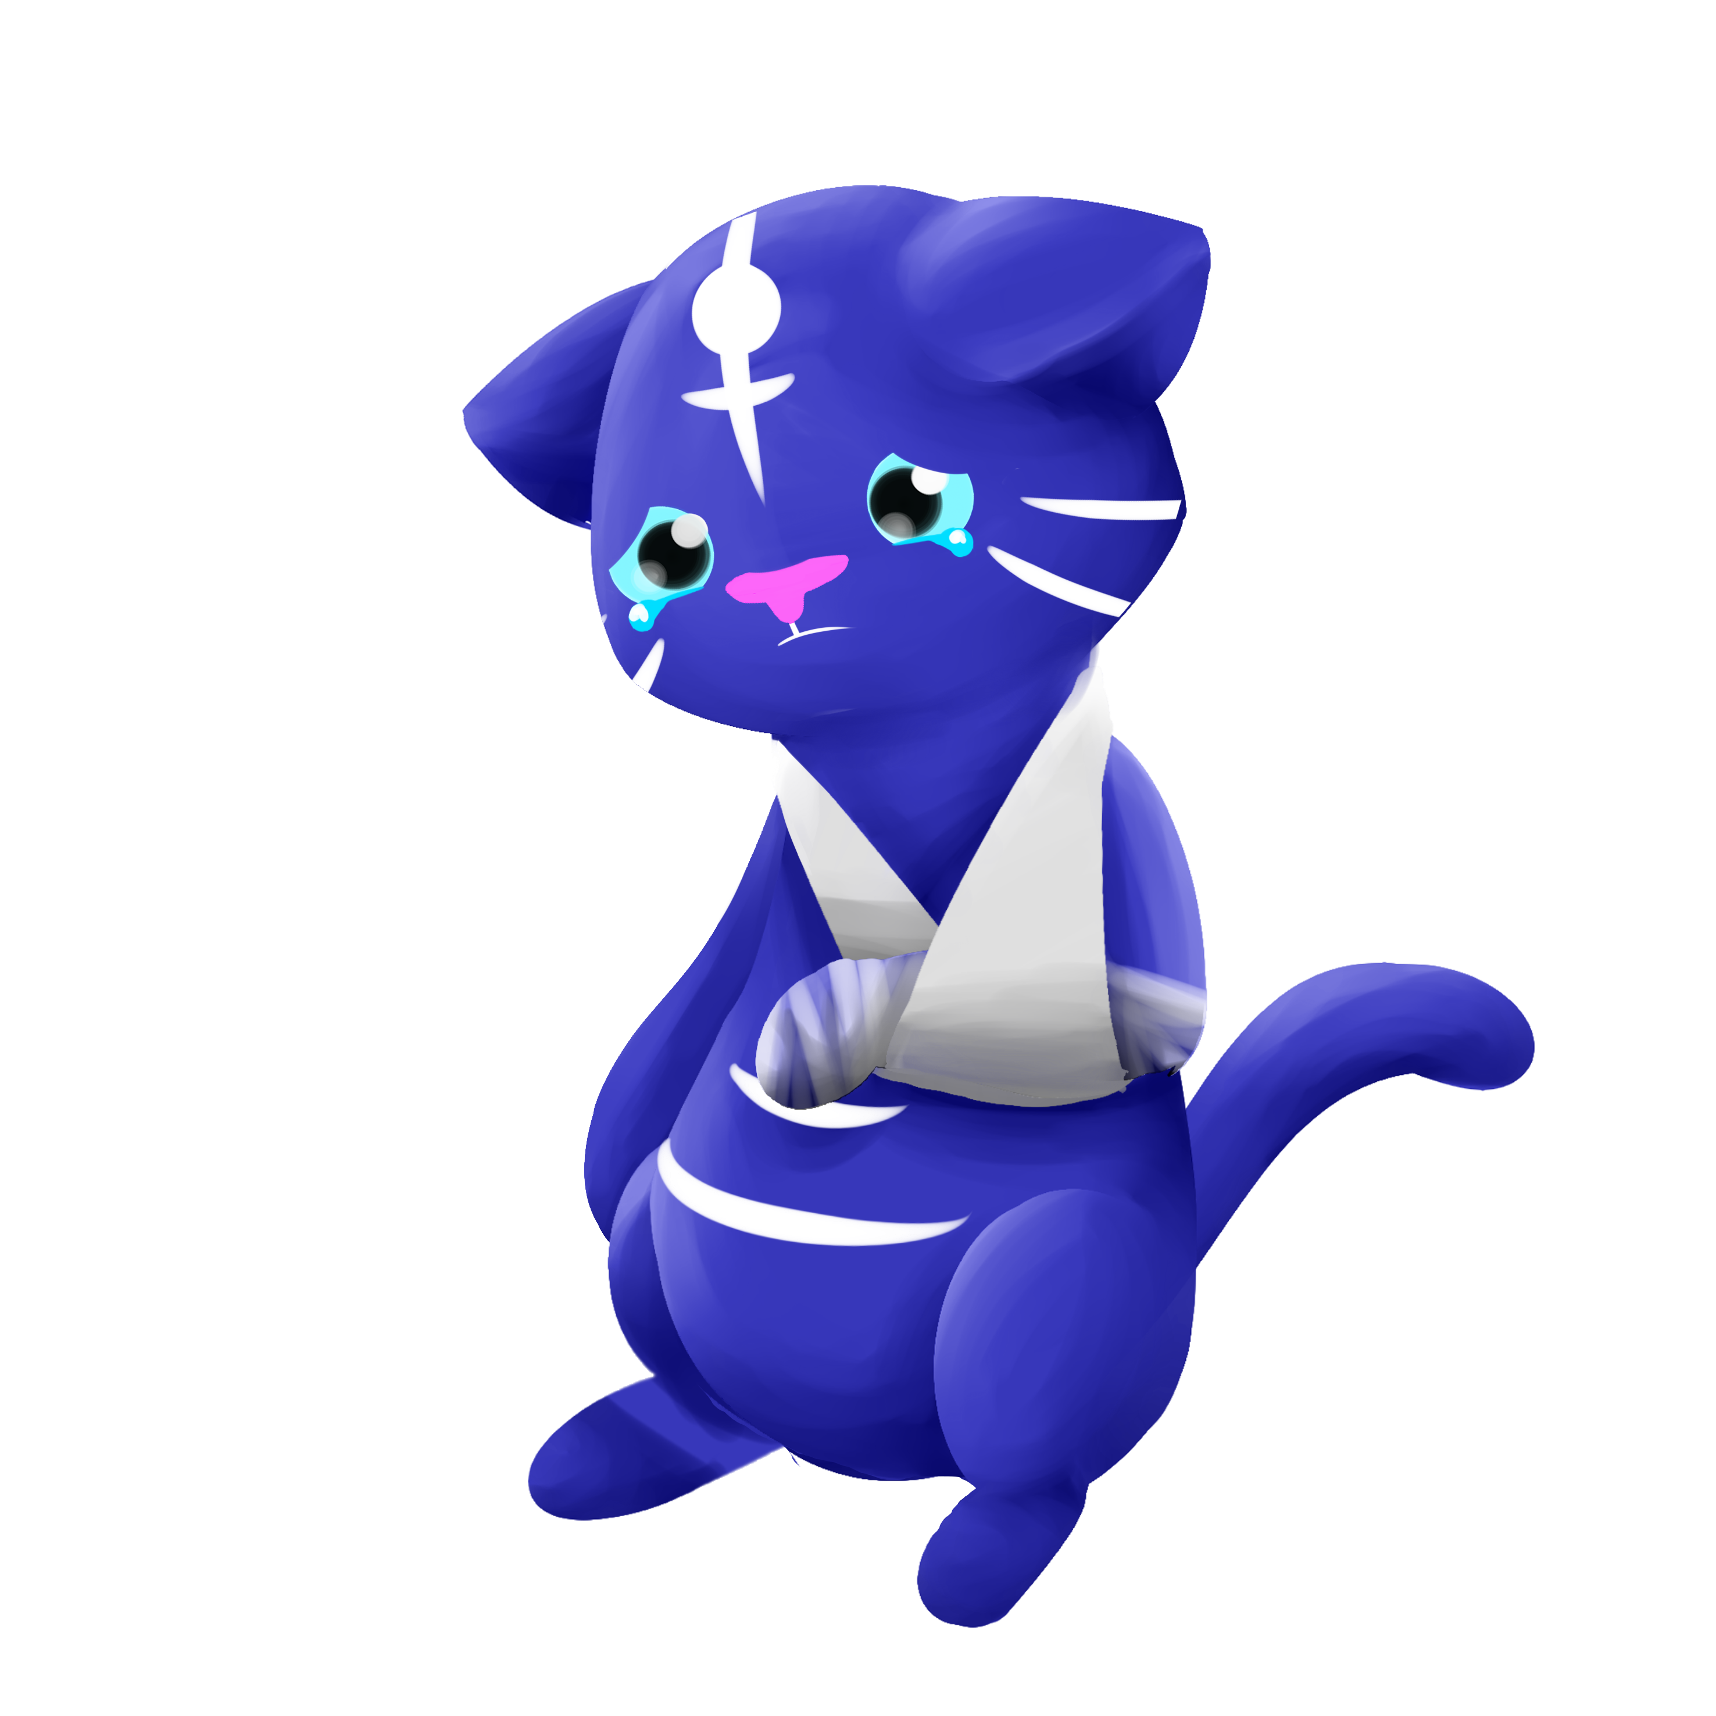
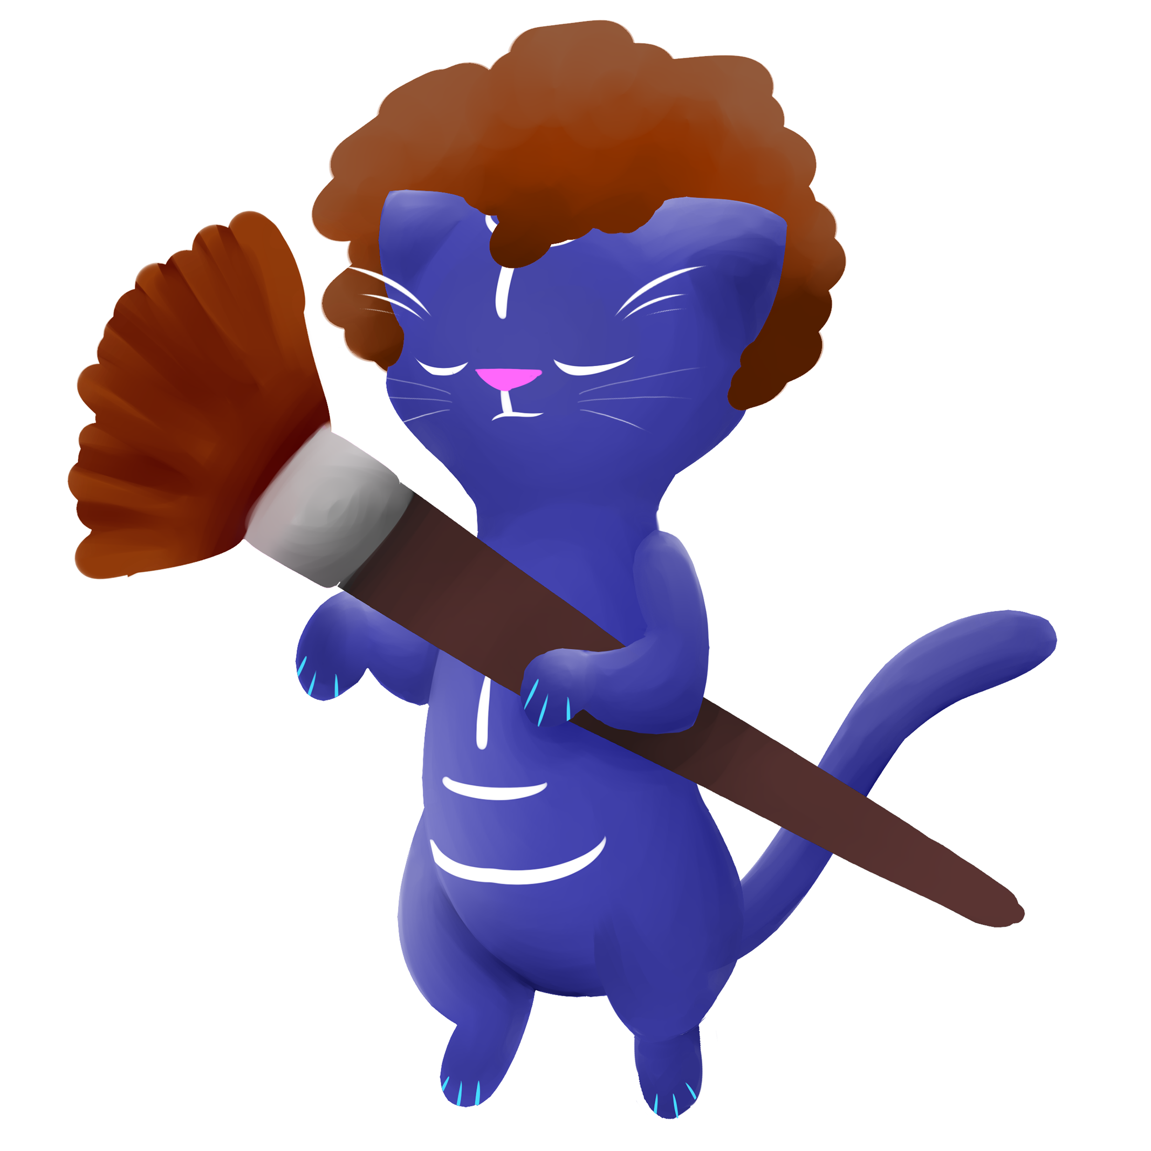

Animal Sprites

Slide 6
Usability Testing
Positive feedback
Art was pleasing
Players enjoyed interacting with the environment.
Liked the freedom of being able to choose colour

Slide 7
Usability Testing
Constructive feedback
Input felt unsatisfying
Some of the colours were over-exposed
UI interfered with game a lot

Slide 8
What we have done
Polish
Fixed colouring values that weren’t working
Rebuilt scenes outside of the prototype version
Visual feedback
Particle effects
Cat sprites

Slide 9
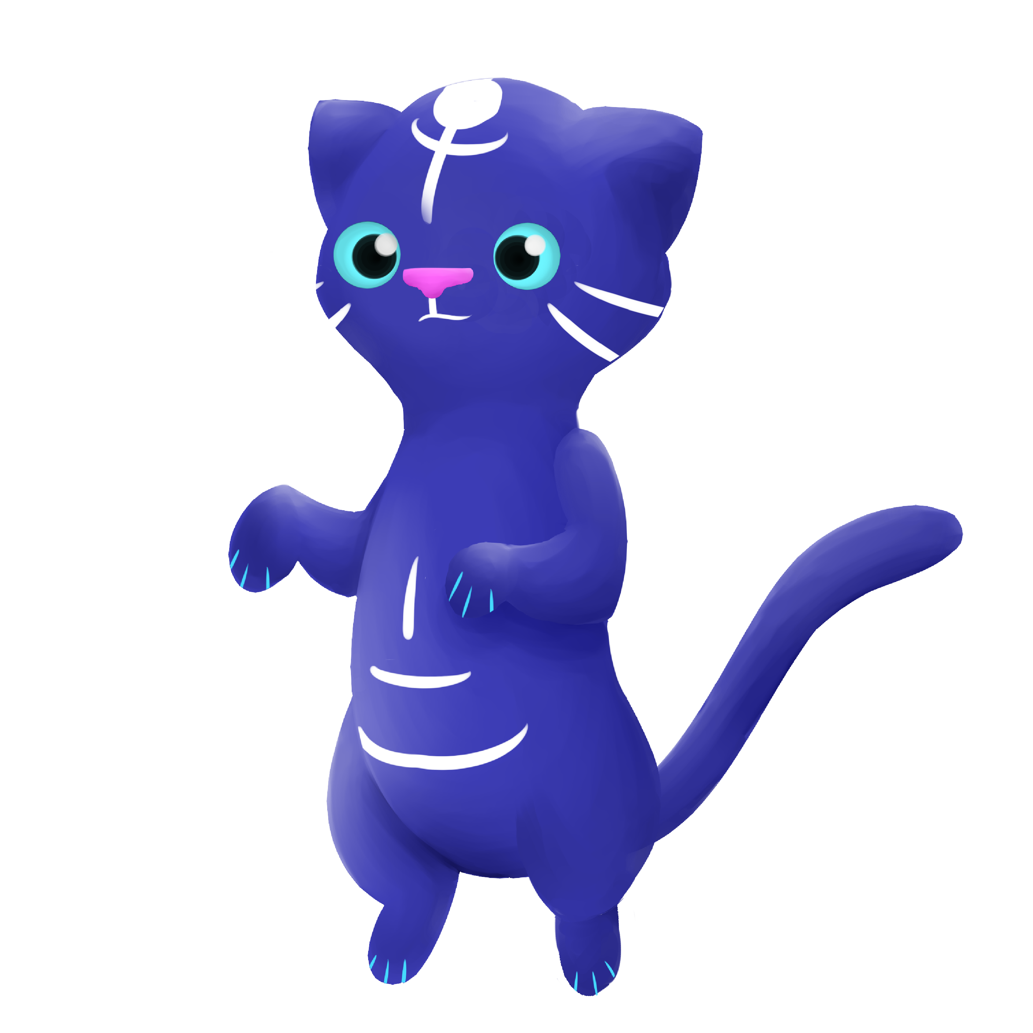
What needs to be done
Polish
Zoom Coding
Link the reward to the particles and sprites
Audio feedback
Ambient sounds
Music
Sound effects

Slide 10
Any questions?

